Slide 1
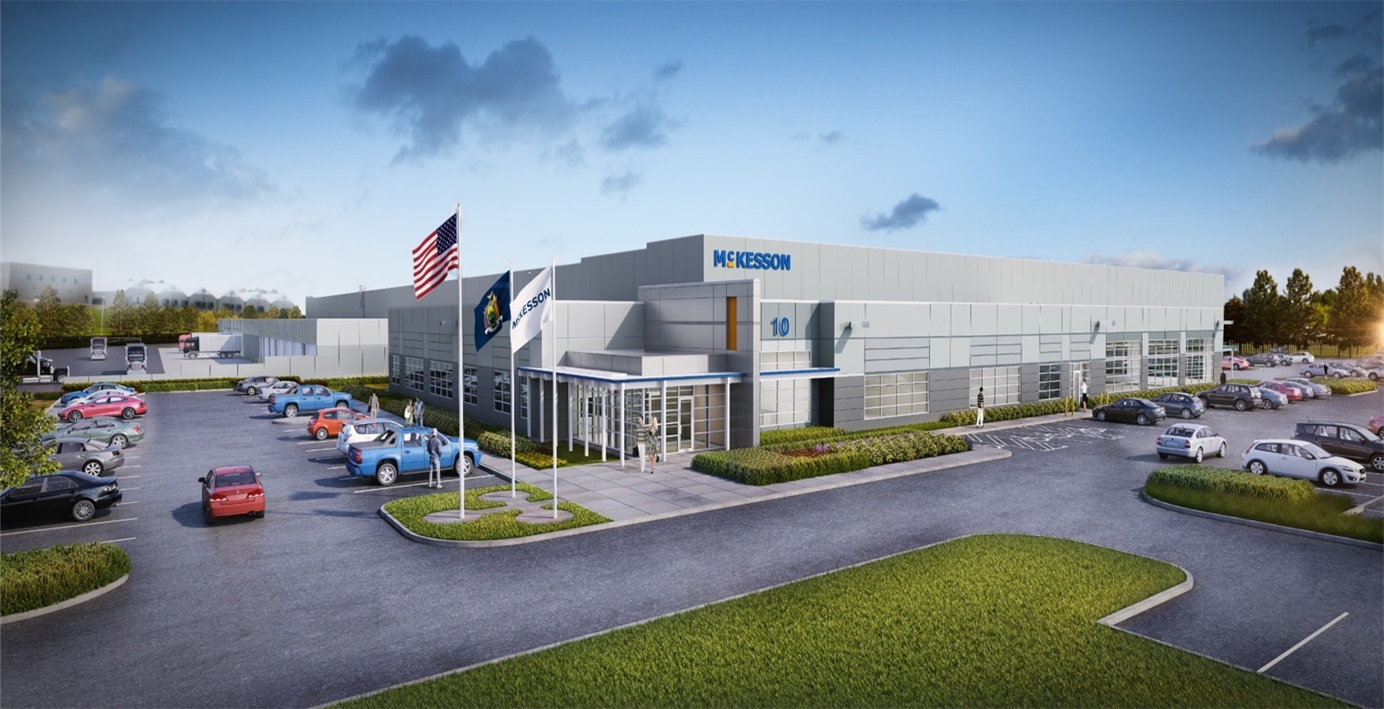
NY Metro Distribution Center
Susan Dean, Director of Operations
Brian Ferreira, Vice President General Manager

Slide 2
Pharmacy Distribution
To improve care in every setting –
one product, one partner, one patient at a time

Slide 3
McKesson Pharmacy Distribution Network
Leveraging a Nationwide Distribution Network
27 Forward Distribution Centers
Driven by Six Sigma methodologies
Completely integrated
Alternate sourcing capabilities
2 Redistribution Centers
Two strategically placed facilities in each section of the country
Backup inventory for forward distribution centers
Aligned with manufacturers
East Region
EAST DC’s
8144 Aurora, IL
8132 Livonia, MI
8164 Wa Courthouse, OH
8110 Boston, MA
8113 Buffalo, NY
8772 New Castle, PA
8160 Montgomery, NY
8155 Robbinsville, NJ
8120 Ruther Glen, VA
8148 Atlanta, GA
8126 Birmingham, AL
8195 Lakeland, FL
8149 Memphis, TN
West Region
WEST DC’s
8145 Clear Lake, IA
8183 St Louis, MO
8130 Anchorage, AK
8131 Denver, CO
8173 Wilsonville, OR
8138 Honolulu, HI
8147 Santa Fe Springs, CA
8182 Sacramento, CA
8170 Tolleson, AZ
8180 Salt Lake City, UT
8165 Oklahoma City, OK
8115 Conroe, TX
8112 Seattle, WA
Strategic Redistribution Center (SRC)
National Redistribution Center (NRDC)
2 Redistribution Centers | 27 Forward Distribution Centers | 2,500 vendors | 43,000 items | 250 cross-docks
Notes:
McKesson Proprietary and Confidential
<number>

Slide 4
McKesson Distribution Network
First two-tier, fully integrated supply chain provides optimal inventory
Redistribution Centers (RDCs)
27 Forward DCs
Manufacturer
Strategic RDC (Denver, CO)
Manufacturer
National RDC (Olive Branch, MS)
Manufacturer
Two strategically placed facilities in each section of the country
Backup inventory for FDCs
Aligned with manufacturers
Continuous measurement and improvement driven by Six Sigma methodologies
Three new state-of-the-art facilities
Completely integrated
Alternate sourcing capability
Notes:
Our unique two-tier distribution network ensures we have the product you need at the distribution center nearest you.
We have 28 distribution centers coast to coast, including 2 redistribution centers strategically placed throughout the nation.
We partner closely with manufacturers to ensure we receive the largest and earliest shipments into our 2 massive re-distribution centers.
Leveraging sophisticated analytics, the re-distribution centers ship daily deliveries to regional distribution centers, ensuring they hold optimal inventory for their local customers.
We continue to invest in our supply chain network, with three state of the art facilities and a new National RDC enhancing our abilities to manage inventory more effectively.
The information presented in this proposal is solely for the purpose of discussion and is not intended as a complete summary of potential terms and conditions envisioned by McKesson. No legally binding obligations would be created until a mutually agreed upon definitive, written supply agreement is executed by and between Captis and McKesson.
<number>

Slide 5
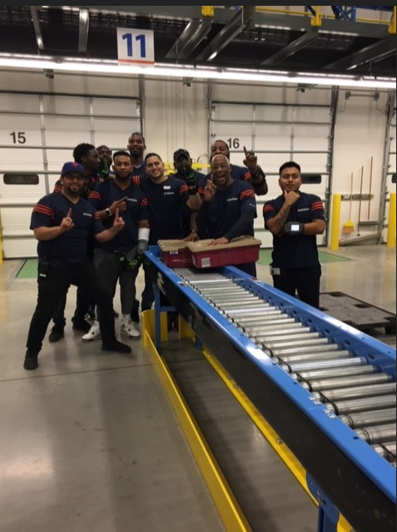
NY Metro Distribution Center Facts
Opened January 15, 2018
  Final accounts transferred by August 30, 2018
Most Efficient New DC Opening
Highest Pharma Engagement Score for 2018
Highest Engagement Score for East Region 2019
Collaborative Engaged Culture
96% of employees new to McKesson
First Order
<number>
06/26/2018
McKesson Confidential and Proprietary

Slide 6
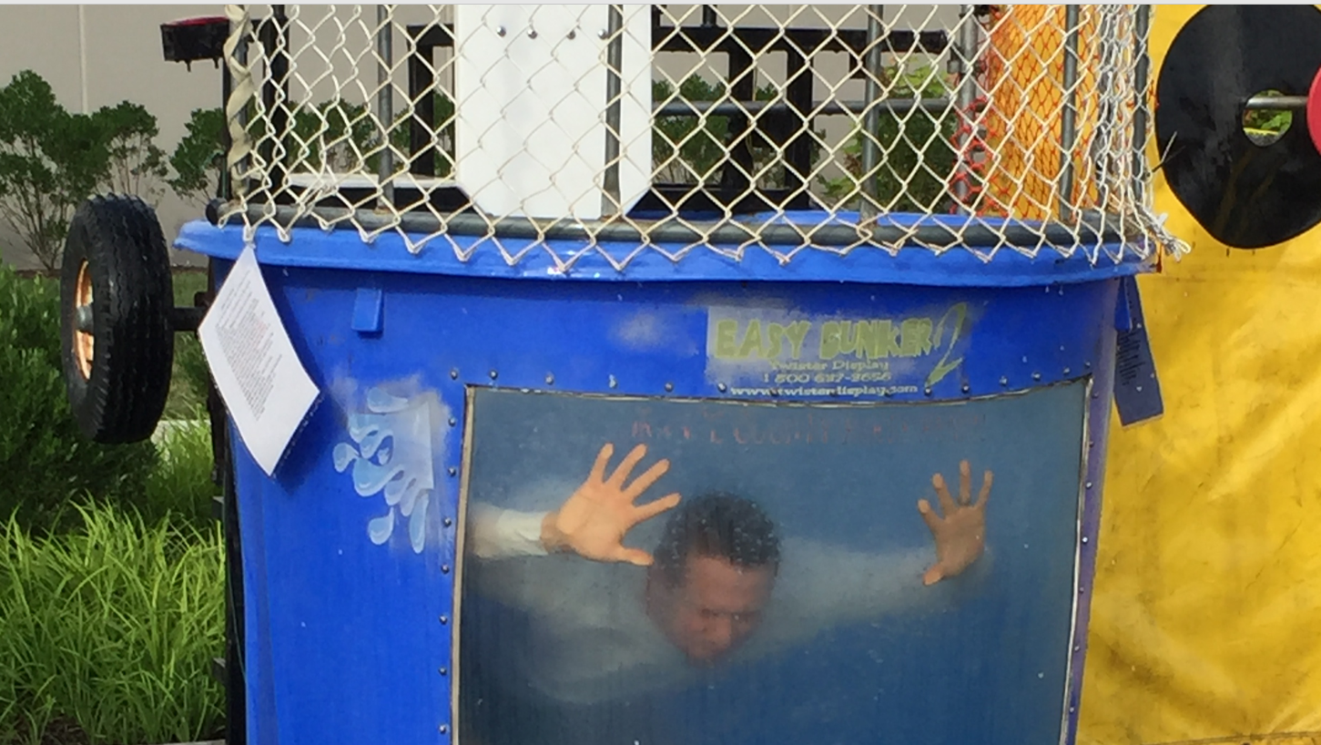
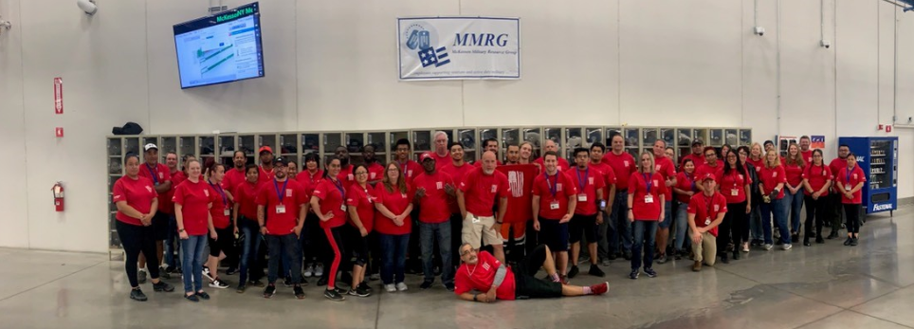
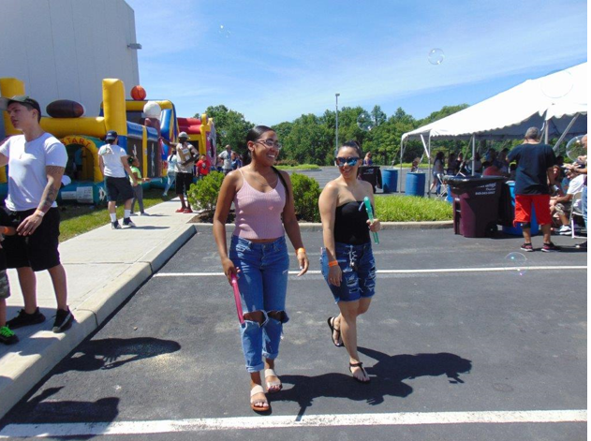
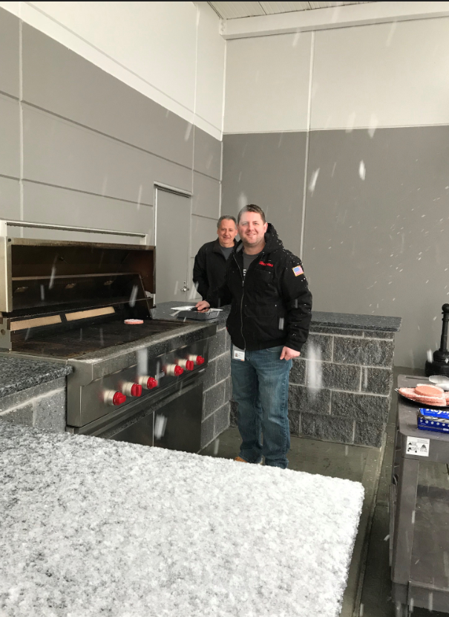
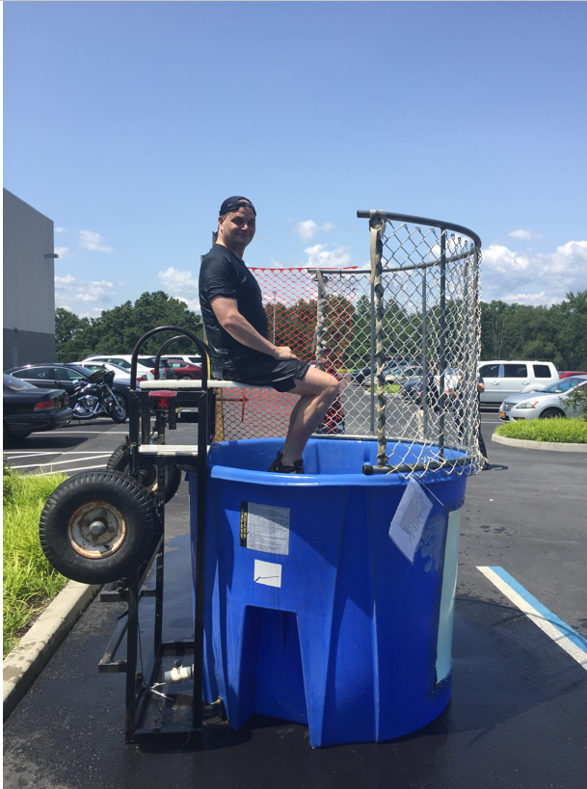
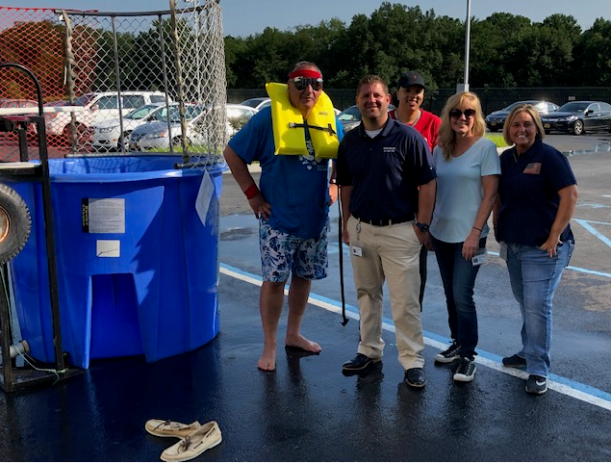

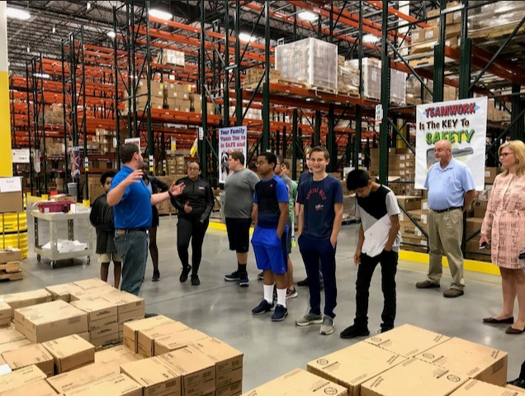

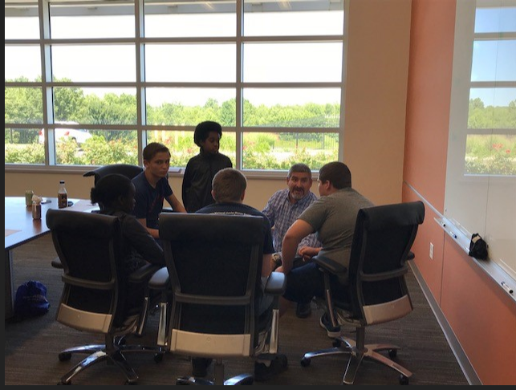
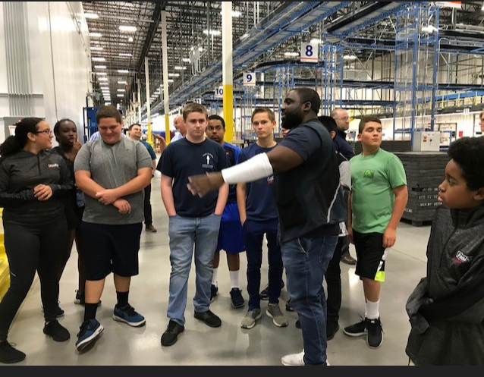
DC Culture - Then
<number>
06/26/2018
McKesson Confidential and Proprietary

Slide 7
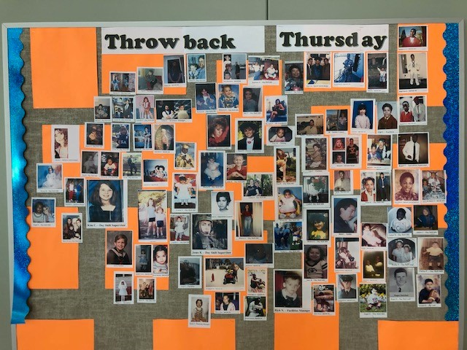
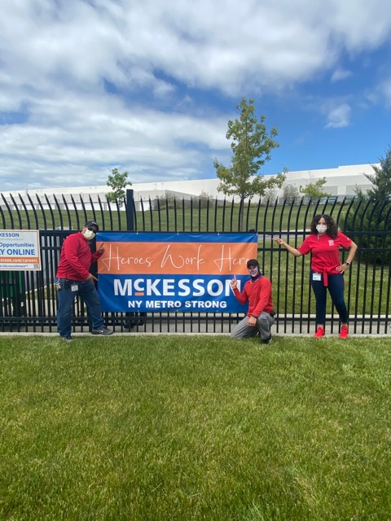
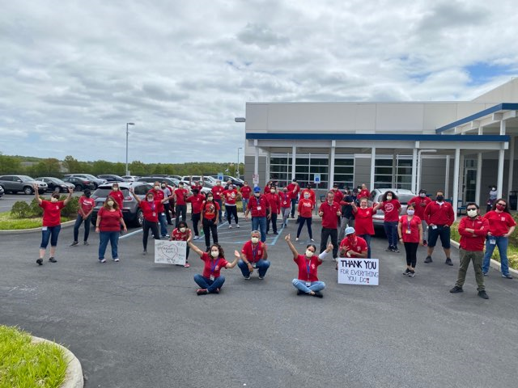
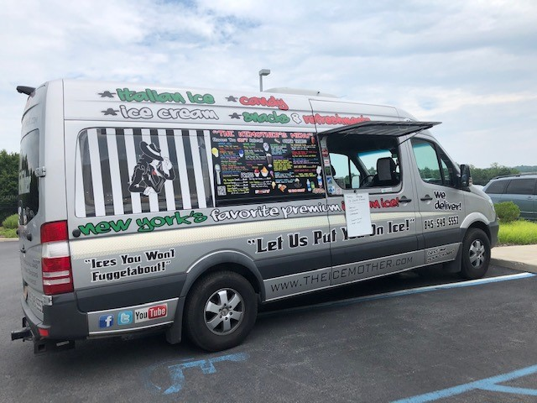
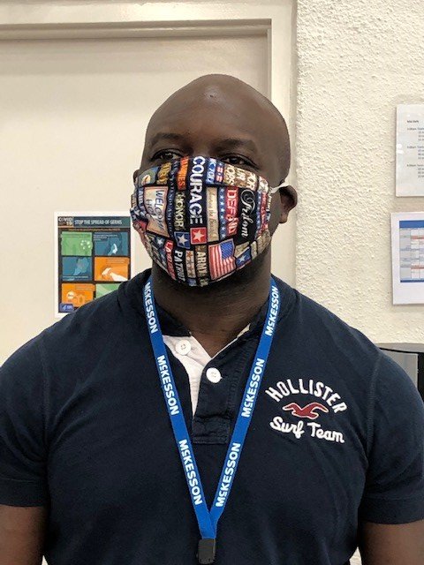
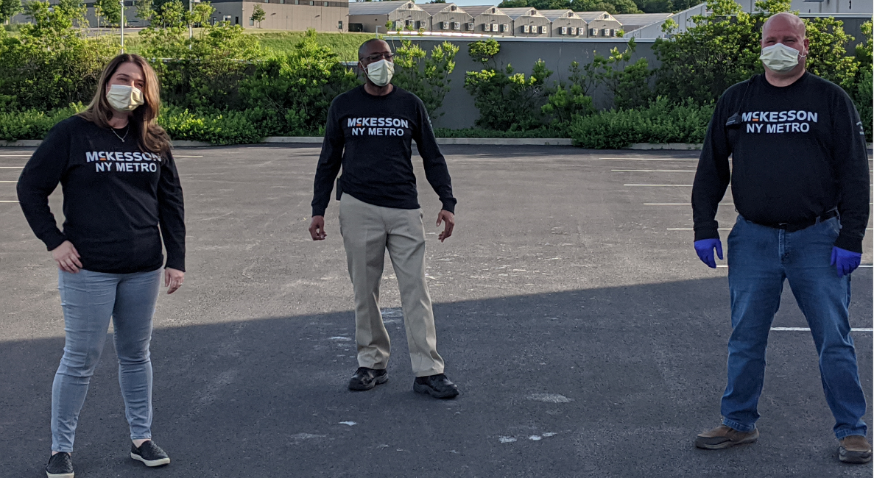
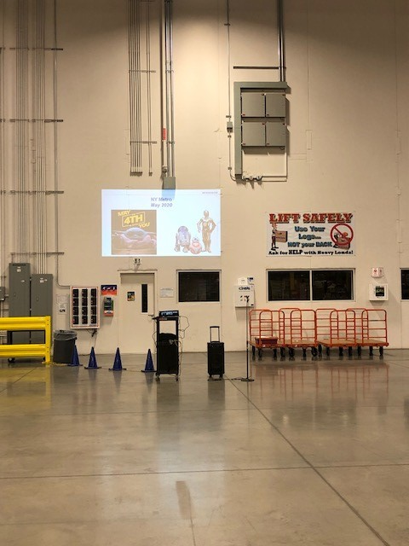

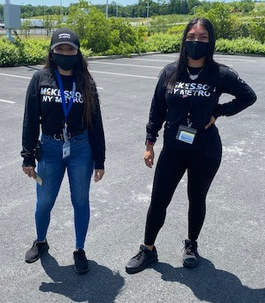
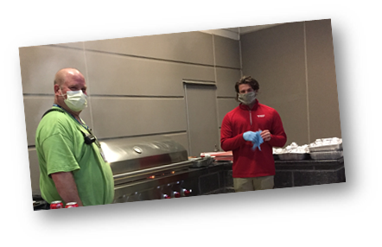
DC Culture - Now
<number>
06/26/2018
McKesson Confidential and Proprietary

Slide 8
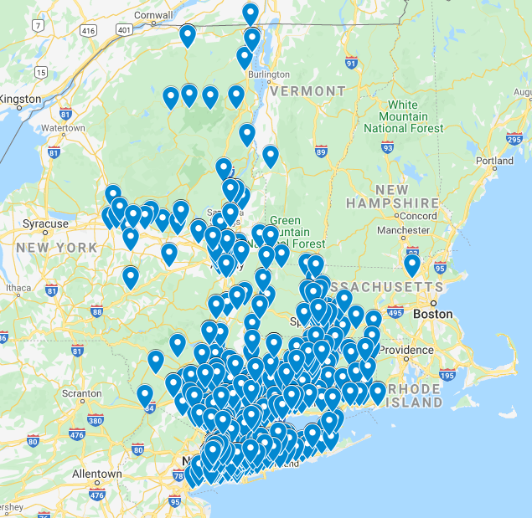
NY Metro
Market
10 Hudson Crossing Drive
Montgomery, NY 12549
Notes:
<number>

Slide 9
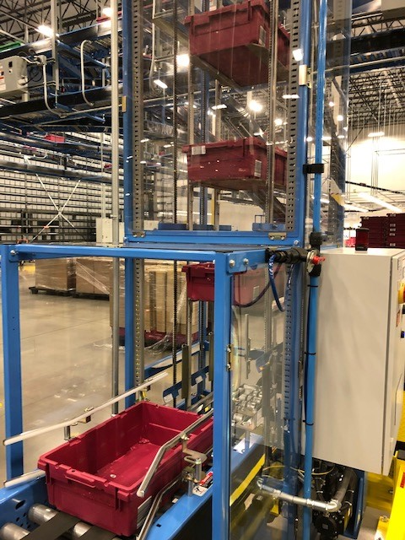
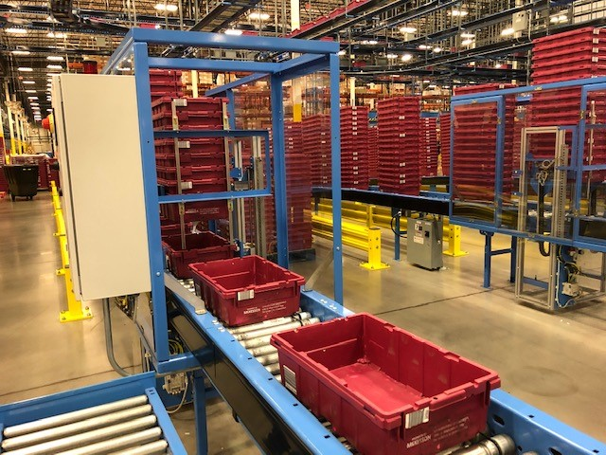
Init Stations – Start
<number>
06/26/2018
McKesson Confidential and Proprietary

Slide 10
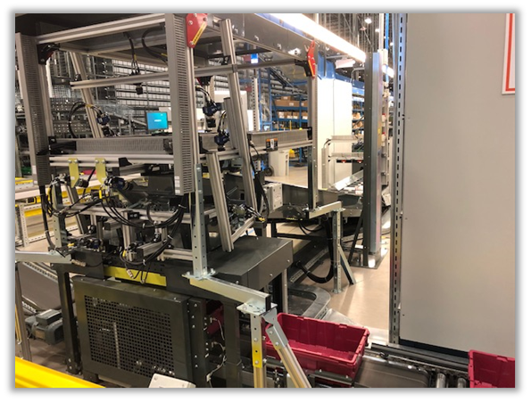
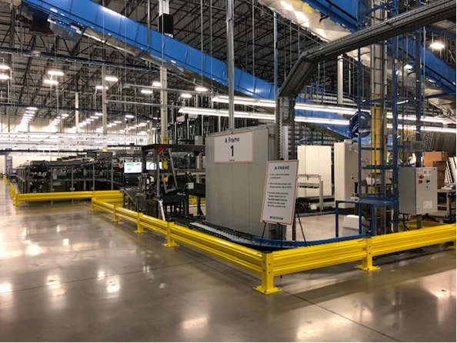
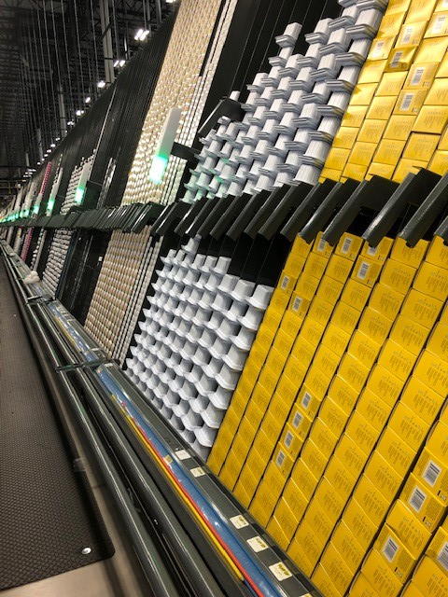

A Frames
Over 2,000 of the fastest moving items
70% of the lines picked with desired success rate of 99.8%
Cameras in the hopper set up to capture the 2D barcode images from the products as they travel down the conveyor belt.
November 27, 2023 – Unit level traceability
<number>
06/26/2018
McKesson Confidential and Proprietary

Slide 11
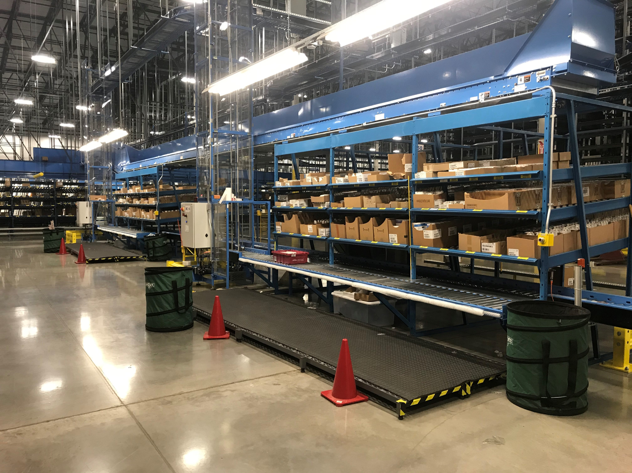
AAA
Two mirrored sections to pick some of the fastest moving items
High volume – more efficient pick
<number>
06/26/2018
McKesson Confidential and Proprietary

Slide 12
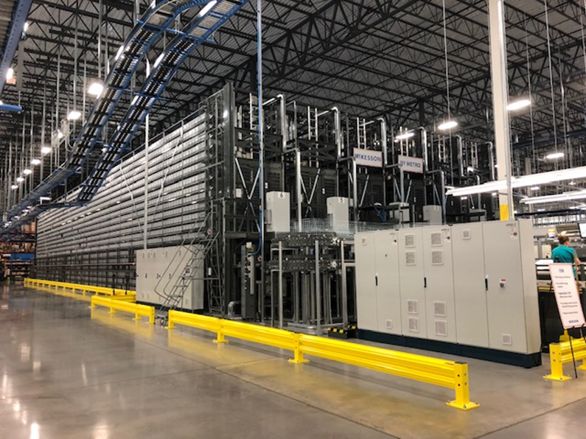
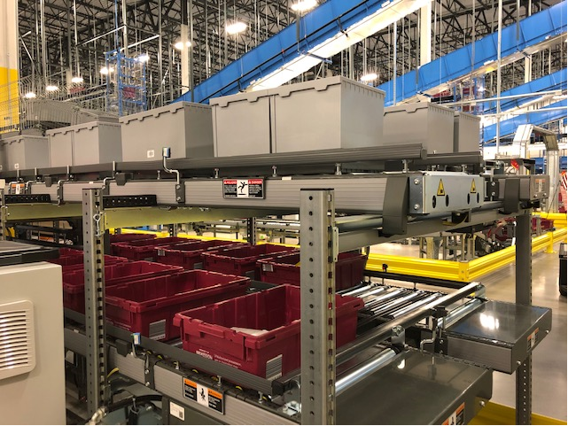
OSR – Order Storage and Retrieval
Over 30,000 storage locations
Approximately 13,000 different items slotted
On average a person can pick 450-500 Lines per Hour (LPH)
Slow moving inventory
<number>
06/26/2018
McKesson Confidential and Proprietary

Slide 13
OSR – Order Storage and Retrieval
<number>
06/26/2018
McKesson Confidential and Proprietary

Slide 14
Manual Pick
Associates use wrist RF scanner unit to pick
Approximately 2,000 items slotted
On average a person can pick over 200 Lines per Hour (LPH) in a section
Medium moving inventory and non-frameable items.
NIOSH/Chemo items included
<number>
06/26/2018
McKesson Confidential and Proprietary

Slide 15
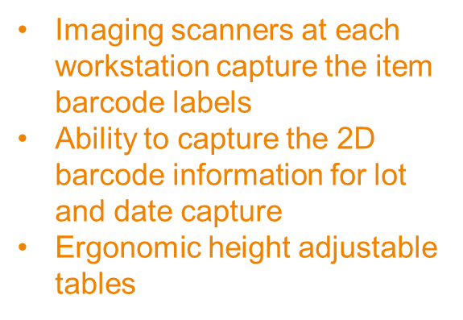
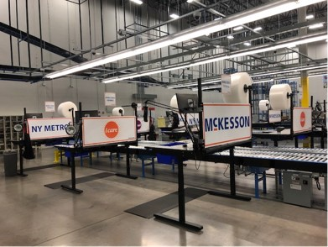
Double Check
<number>
06/26/2018
McKesson Confidential and Proprietary

Slide 16
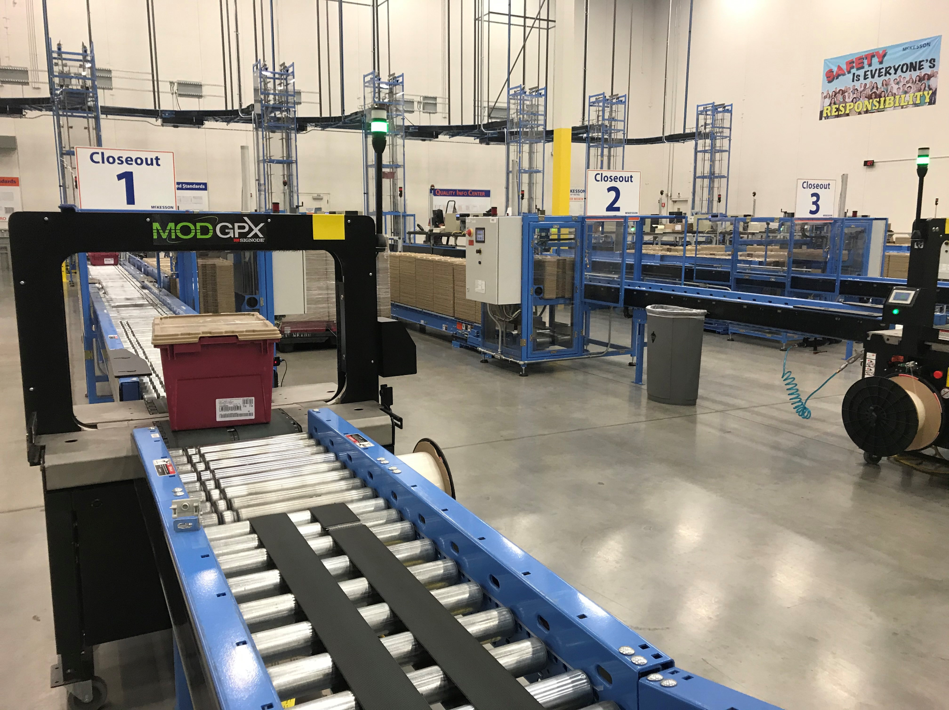
Close Out
Unmanned area where totes travel prior to shipping
Price labels automatically print and are inserted
Tote label affixed
Tote lid secured
Tote banded
<number>
06/26/2018
McKesson Confidential and Proprietary

Slide 17
Close Out
<number>
06/26/2018
McKesson Confidential and Proprietary

Slide 18
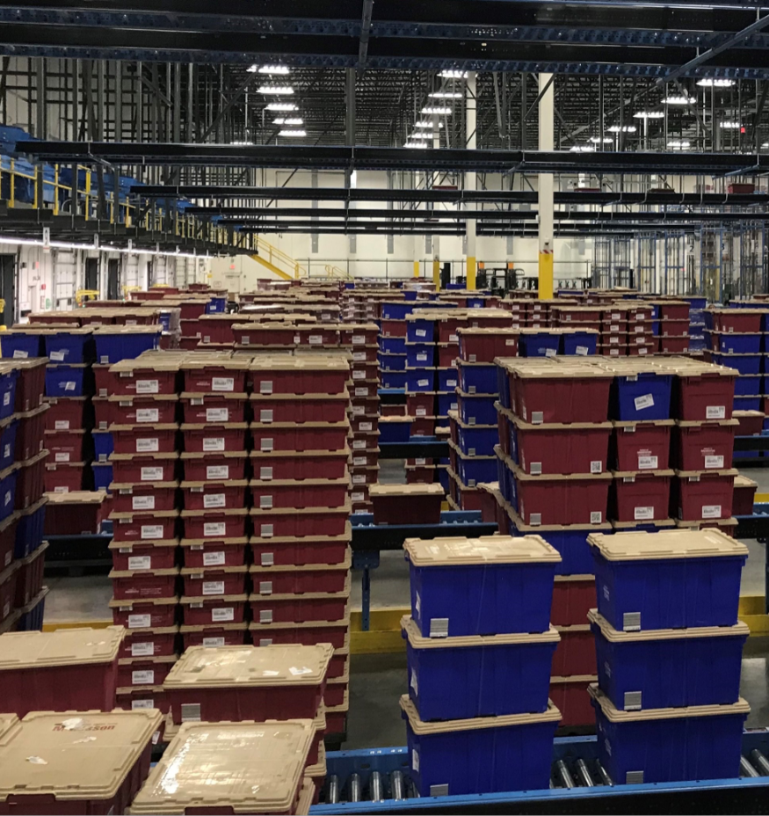
Shipping
13 shipping lanes assigned to specific line hauls that allow for over 10,000 totes to be sorted and shipped each evening
35,000 square foot space
<number>
06/26/2018
McKesson Confidential and Proprietary

Slide 19
Shipping
<number>
06/26/2018
McKesson Confidential and Proprietary

Slide 20
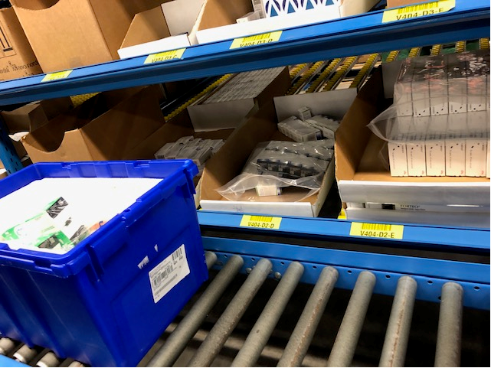
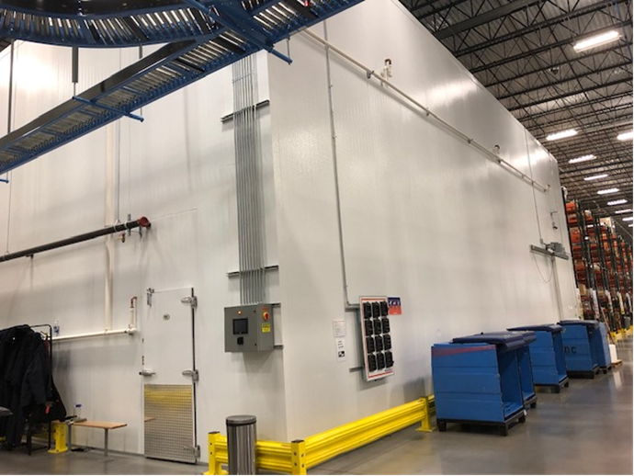
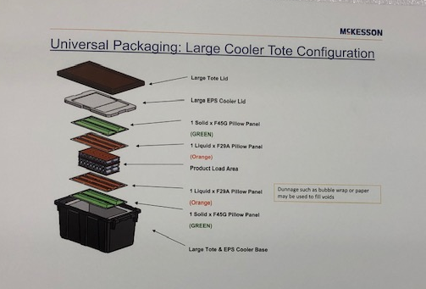
Specialty Areas – Cage, Vault, Biobox
Biobox temperature maintained between 36 – 46 degrees
Approximately 625 different items slotted
12,068 square foot space with mezzanine (second floor)
Complete process – doublecheck and closeout
<number>
06/26/2018
McKesson Confidential and Proprietary

Slide 21
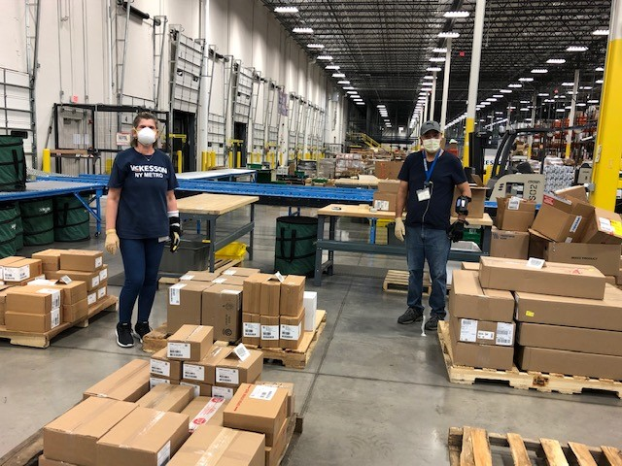
Dayshift Operations
Key Focus
  Receiving
    Small Parcel – FedEx & UPS
    Full and partial pallet
  Putaway
  Returns Processing
<number>
06/26/2018
McKesson Confidential and Proprietary

Slide 22
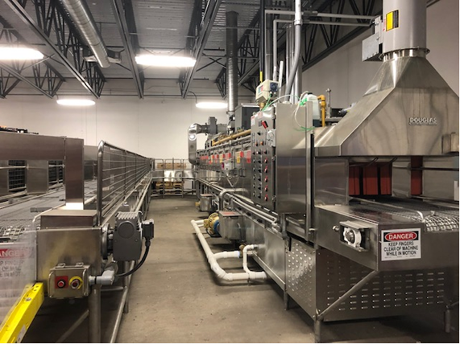
Tote Washer
<number>
06/26/2018
McKesson Confidential and Proprietary

Slide 23
NY Metro Video
<number>
06/26/2018
McKesson Confidential and Proprietary

